Slide 1

School of Computer Engineering and Technology Deep Learning Project
Image Captioning Using Attention
Students Name:
- Raviraj Tekale (202302040010)
- Vedant Puri (202302040011)
- Ajay Ingle (202302040021)
Guide: Mrs. Deepti Chikmurge

Slide 2
Index
1. Problem Statement & Objectives
2. Proposed Method
3. Dataset Description
4. Architecture Flow
5. Comparative Analysis
6. Evaluation Metrics
7. Conclusion and References

Slide 3
Problem Statement
Image captioning is the task of generating meaningful textual descriptions for a given image.
Traditional methods often lack deep understanding of objects and contextual relationships.
Aim: Design a model that mimics human perception using attention mechanisms.

Slide 4
Objectives
-Develop an image captioning model for accurate and human-like captions.
- Use ResNet-50 encoder for visual feature extraction.
- Implement two decoder variants:
- Baseline LSTM
- LSTM with Bahdanau attention
- Train and evaluate on Flickr8k using BLEU scores.
-Compare performance of attention-based vs. non-attention-based models.

Slide 5
Proposed Method
Model: Encoder–Decoder Architecture
- Encoder: Pretrained ResNet-50
- Decoder: LSTM with Bahdanau Attention
- Attention focuses on relevant image regions
- Implemented in PyTorch
- Evaluated using BLEU scores
Tools & Frameworks:
- PyTorch
- Flickr8k Dataset
- BLEU and ROUGE Scores
- GPU-enabled training

Slide 6
Dataset Description
- Name: Flickr8k Image Captioning Dataset
- Images: ~8,000 real-world images
- Captions: 5 captions per image (human-written)
- Source: Flickr (public domain)
- Content: People and animals performing actions
- Purpose: Train models to map visual features to language

Slide 7
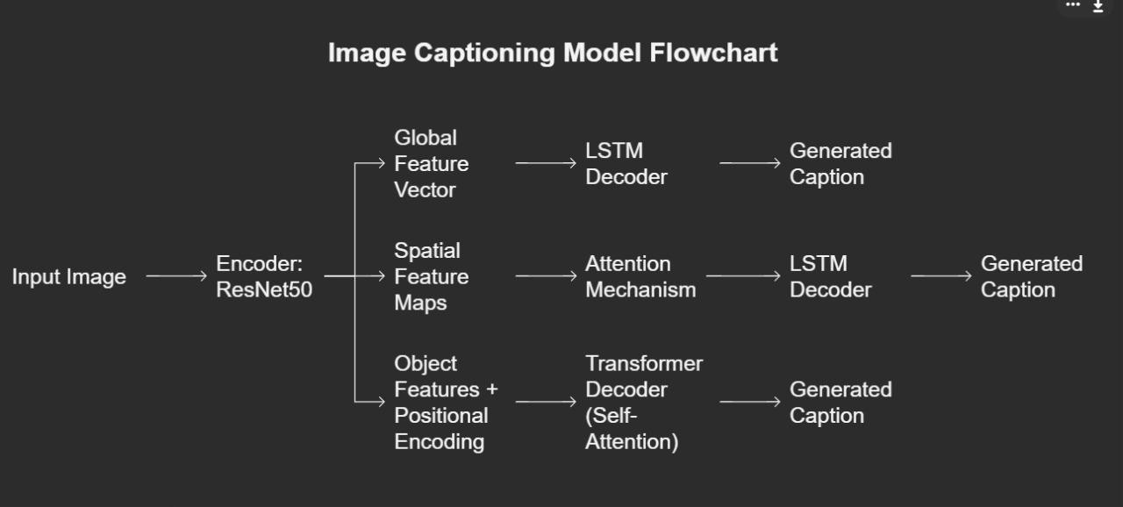
Architecture Flow

Slide 8
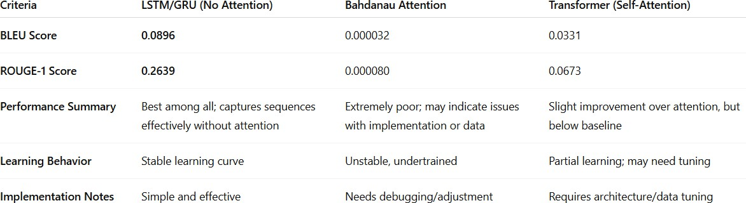
Comparative Analysis

Slide 9
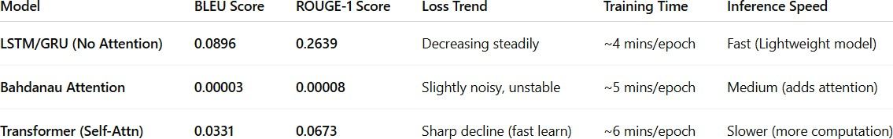
Evaluation Metrics
BLEU Score (Bilingual Evaluation Understudy)
Higher = Better translation or caption quality.
ROUGE Score (Recall-Oriented Understudy for Gisting Evaluation)
Useful for summarization and generation tasks.
Loss Curve
Shows how well the model is learning during training.

Slide 10
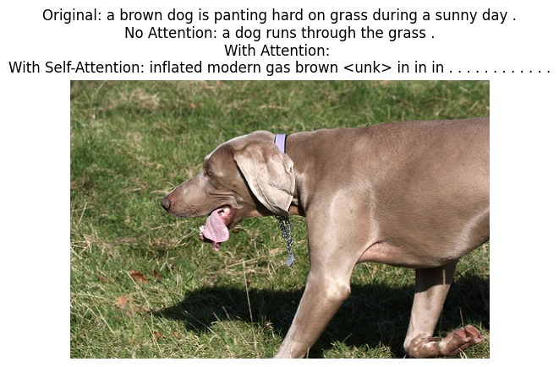
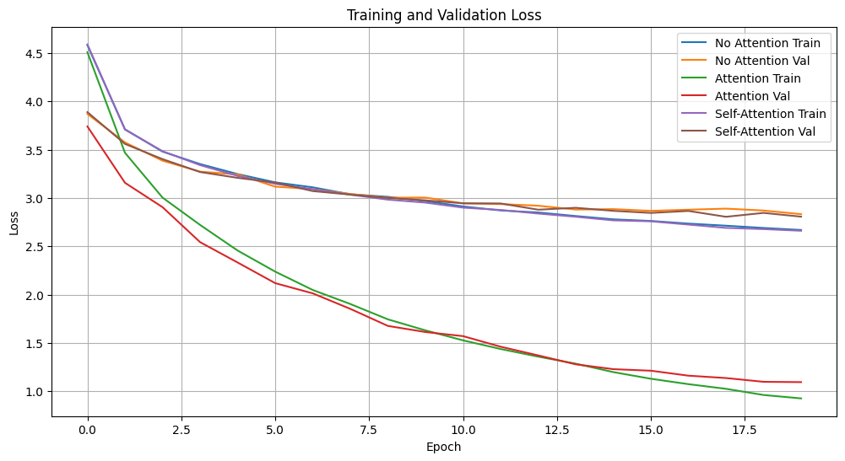

Slide 11
Conclusion
The Encoder-Decoder architecture effectively addresses sequence-to-sequence learning challenges by encoding variable-length input into a fixed representation and decoding it to generate meaningful outputs. This model forms the backbone of many NLP tasks such as machine translation, text summarization, and more. Our implementation demonstrates how this architecture can learn temporal dependencies and generate accurate sequence predictions using RNN-based components and teacher forcing during training.

Slide 12
References
https://journalofbigdata.springeropen.com/articles/10.1186/s40537-022-00571-w

